Slide 1





Data Definition and Data Types
Managing DBs using IDEs
Data Types
SoftUni Team
Technical Trainers
SQL
Software University
http://softuni.bg

Slide 2

Table of Contents
Data Types
Database Modeling
Basic SQL Queries and Table Customization
Deleting Data and Structures

Slide 3
Questions
sli.do #mysql

Slide 4
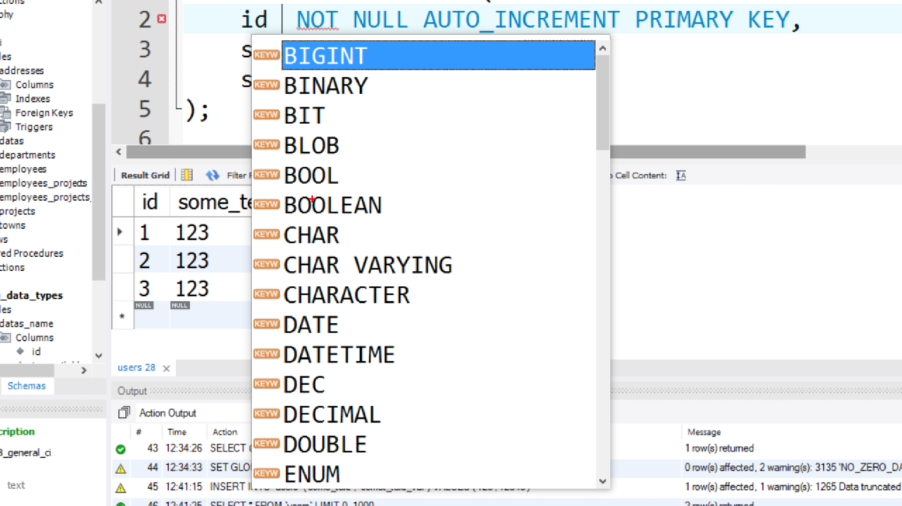

Data Types in MySQL Server

Slide 5
Data Types in MySQL Server
Numeric
INT [(M)] [UNSIGNED] [ZEROFILL]
TINYINT [(M)] [UNSIGNED] [ZEROFILL]
DOUBLE [(M, D)] [UNSIGNED] [ZEROFILL]
DECIMAL [(M, D )] [UNSIGNED] [ZEROFILL]
Column Name | Column Type
customer_id | INT (BIGINT)
is_online | TINYINT (BIT)
balance | DECIMAL (DOUBLE)

Slide 6
Data Types in MySQL Server (2)
Strings
CHAR [(M)] [CHARACTER SET charset_name] [COLLATE collation_name]
VARCHAR(M) [CHARACTER SET charset_name] [COLLATE collation_name]
TEXT [(M)] [CHARACTER SET charset_name] [COLLATE collation_name]
BLOB [(M)]
Column Name | Column Type
title | VARCHAR(CHAR)
content | TEXT(LONGTEXT)
picture | BLOB(LONGBLOB)

Slide 7
Data Types in MySQL Server (3)
Date and Time
DATE
TIME
DATETIME
TIMESTAMP
Column Name | Column Type
birthdate | DATE
last_time_online | TIMESTAMP
start_at | TIME
deleted_on | DATETIME

Slide 8


Database Modeling
Data Definition using IDEs

Slide 9
Working with IDEs
We will manage databases with the following GUI clients:
HeidiSQL
MySQL Workbench
Enables us:
To create a new database
To create objects in the database (tables, stored procedures, relationships and others)
To change the properties of objects
To enter records into the tables

Slide 10
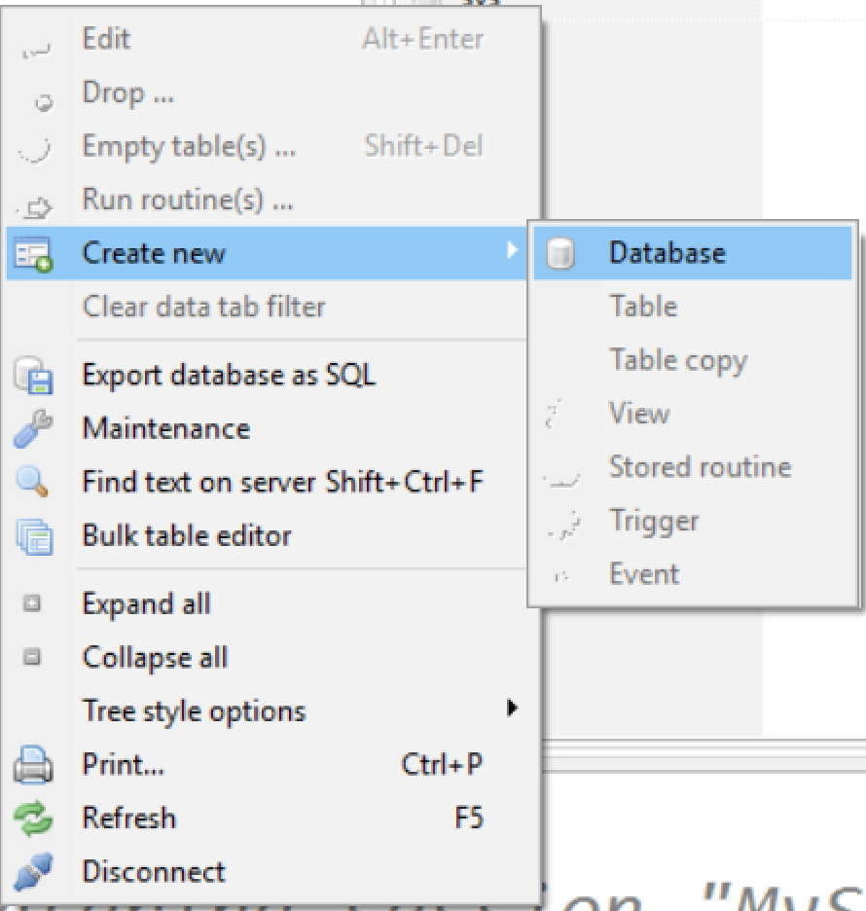
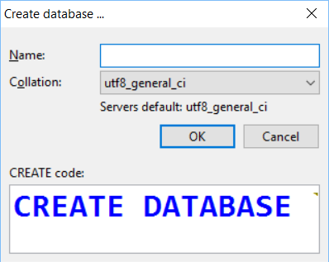
Creating a New Database
Select Create new -> Database from the context menu

Slide 11
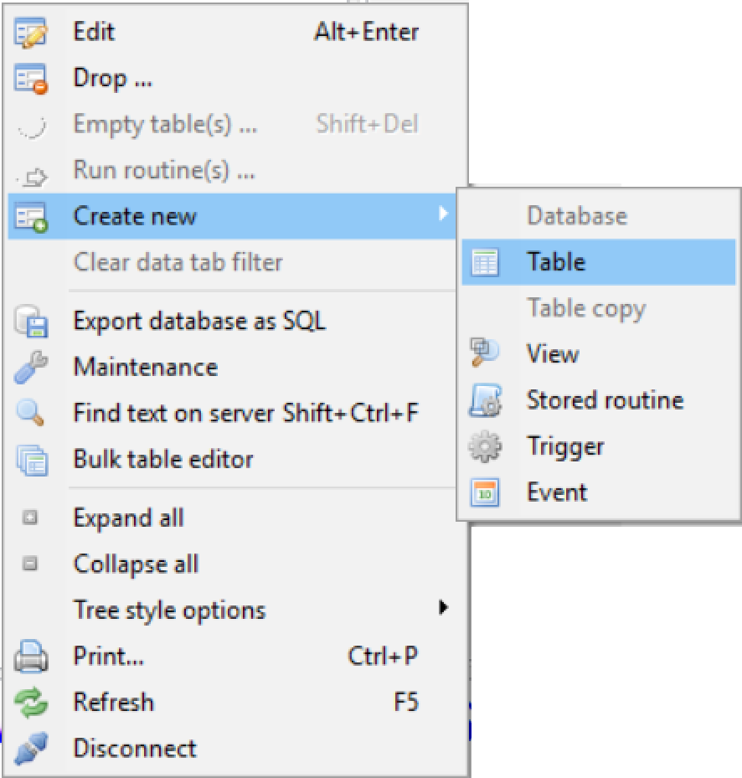
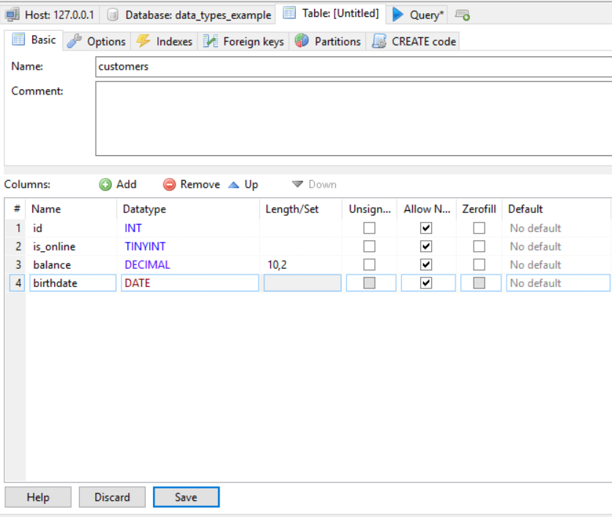
Creating Tables
Right click – Select Create new -> Table

Slide 12
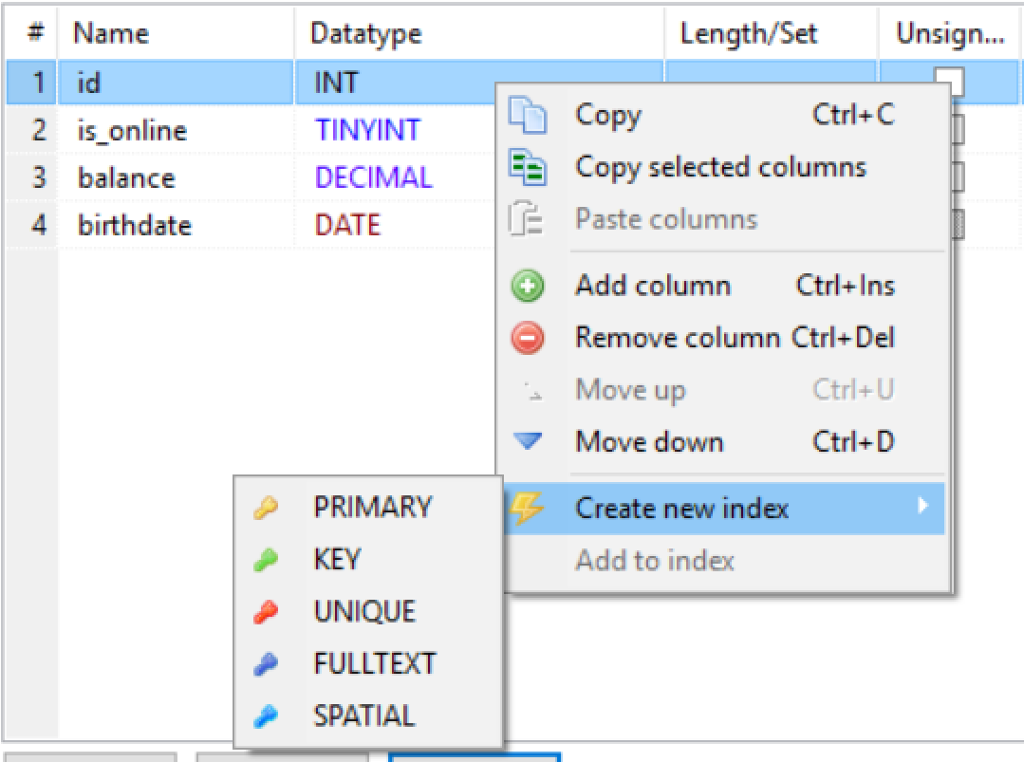
Creating Tables (2)
A Primary Key is used to uniquely identify and index records
Click Create new index -> Primary from the context menu of the desired row

Slide 13
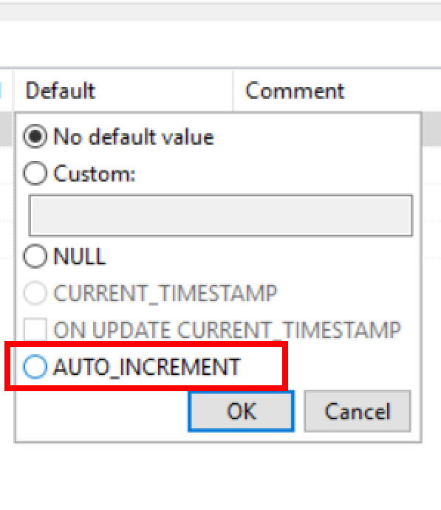
Creating Tables (3)
Auto increment

Slide 14
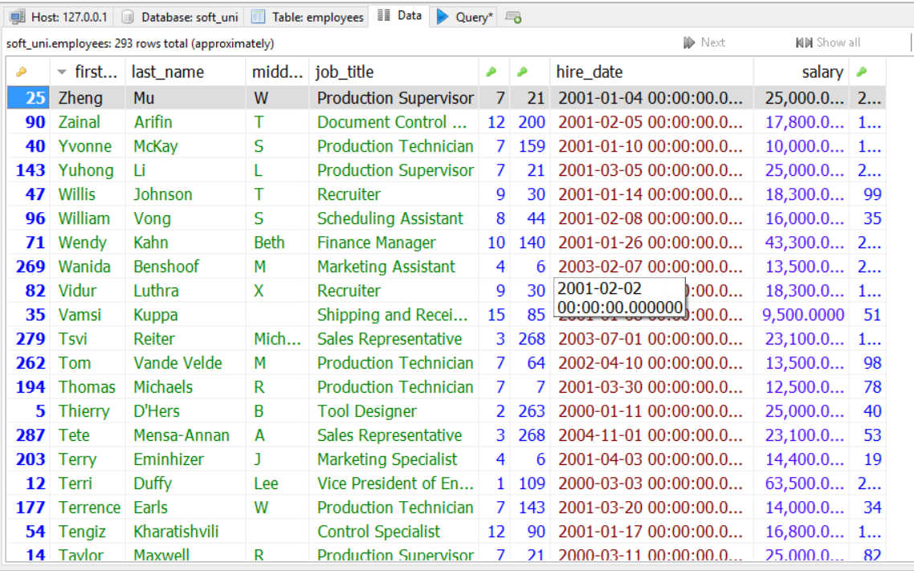
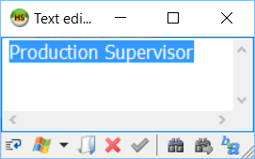
Storing and Retrieving Data
We can add, modify and read records with Ides
To insert or edit a record, click the cell

Slide 15
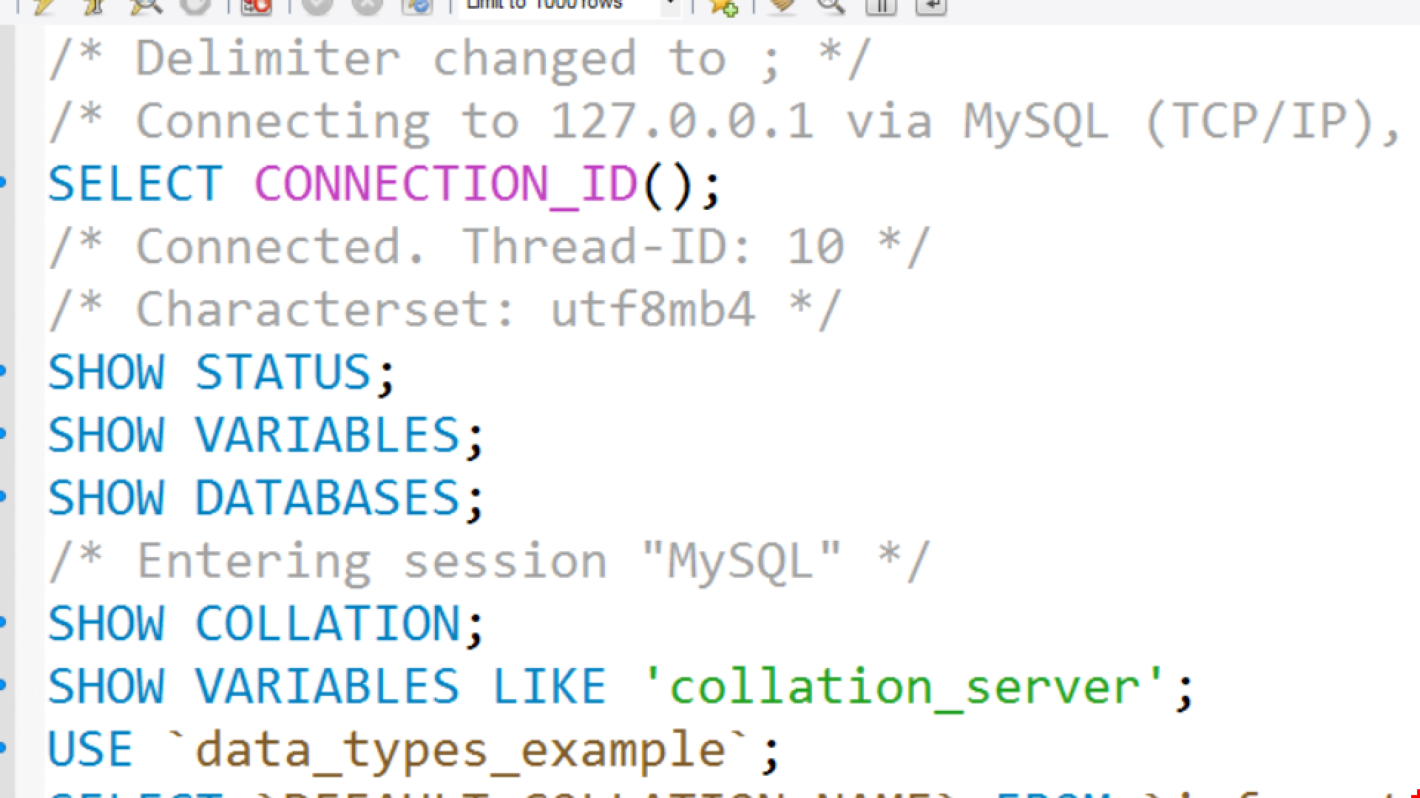
Basic SQL Queries
Data Definition using SQL

Slide 16
SQL Queries
We can communicate with the database engine using SQL
Queries provide greater control and flexibility
To create a database using SQL:
SQL keywords are traditionally capitalized
Database name
CREATE DATABASE employees;

Slide 17
Table Creation in SQL
Table name
CREATE TABLE people
(
id INT NOT NULL,
email VARCHAR(50) NOT NULL,
first_name VARCHAR(50),
last_name VARCHAR(50)
);
Custom properties
Column name
Data type

Slide 18
Retrieve Records in SQL
To get all information from a table
You can limit the columns and number of records
Table name
SELECT * FROM employees;
SELECT first_name, last_name FROM employees LIMIT 5;
Number of records
List of columns

Slide 19

Table Customization
Adding Rules, Constraints and Relationship

Slide 20
Custom Column Properties
Primary Key
Auto-Increment (Identity)
Unique constraint – no repeating values in entire table
Default value – if not specified (otherwise set to NULL)
id INT NOT NULL PRIMARY KEY
id INT AUTO_INCREMENT PRIMARY KEY
email VARCHAR(50) UNIQUE
balance DECIMAL(10,2) DEFAULT 0

Slide 21
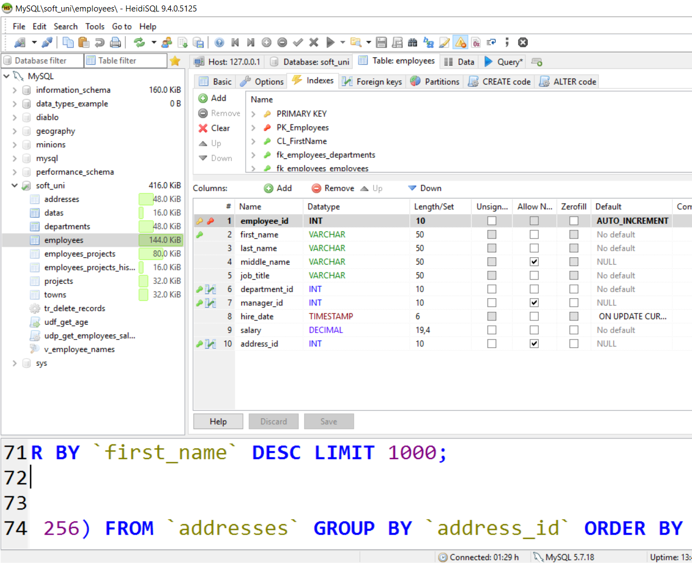
Altering Tables
Changing Table Properties After Creation

Slide 22
Altering Tables Using SQL
A table can be changed using the keywords ALTER TABLE
Add new column
ALTER TABLE employees;
Table name
ALTER TABLE employees
ADD salary DECIMAL;
Column name
Data type

Slide 23
Altering Tables Using SQL (2)
Delete existing column
Modify data type of existing column
Column name
ALTER TABLE people
DROP COLUMN full_name;
ALTER TABLE people MODIFY COLUMN email VARCHAR(100);
Column name
New data type

Slide 24
Altering Tables Using SQL (3)
Add primary key to existing column
Add unique constraint
Constraint name
ALTER TABLE people ADD CONSTRAINT pk_id
PRIMARY KEY (id);
Column name
(more than one for composite key)
Constraint name
ALTER TABLE people ADD CONSTRAINT uq_email
UNIQUE (email)
Columns name(s)

Slide 25
Altering Tables Using SQL (4)
Set default value
Default value
ALTER TABLE people ALTER COLUMN balance SET DEFAULT 0;
Column name

Slide 26
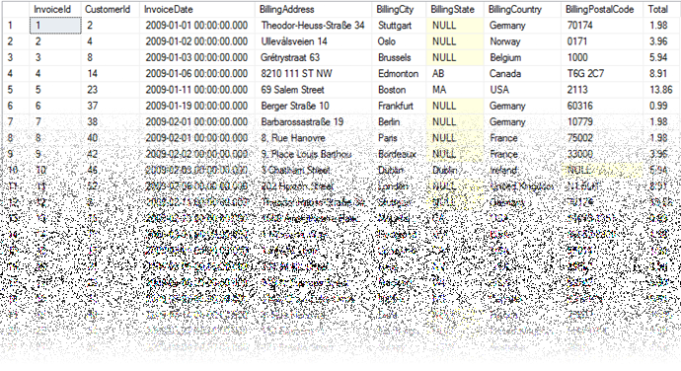
Deleting Data and Structures

Slide 27
Deleting from Database
Deleting structures is called dropping
You can drop keys, constraints, tables and entire databases
Deleting all data in a table is called truncating
Both of these actions cannot be undone – use with caution!

Slide 28
Dropping and Truncating
To delete all the entries in a table
To drop a table – delete data and structure
To drop entire database
TRUNCATE TABLE employees;
Table name
DROP TABLE employees;
Table name
Database name
DROP DATABASE soft_uni;

Slide 29
Dropping and Truncating (2)
To remove a constraining rule from a column
This includes primary keys, value constraints and unique fields
To remove default value (if not specified, revert to NULL)
Table name
ALTER TABLE employess DROP CONSTRAINT pk_id;
Constraint name
Table name
ALTER TABLE employess ALTER COLUMN clients
DROP DEFAULT;
Columns name

Slide 30

Summary
Table columns have a fixed type
Setting up the database is the last step of the design process
We can use IDEs to create and customize tables
SQL provides greater control
CREATE TABLE people
(
id INT NOT NULL,
email VARCHAR(50) NOT NULL,
first_name VARCHAR(50),
last_name VARCHAR(50)
);

Slide 31







Data Definition and Data Types
https://softuni.bg/courses/

Slide 32
License
This course (slides, examples, demos, videos, homework, etc.) is licensed under the "Creative Commons Attribution-NonCommercial-ShareAlike 4.0 International" license
Attribution: this work may contain portions from
"Databases" course by Telerik Academy under CC-BY-NC-SA license

Slide 33




Free Trainings @ Software University
Software University Foundation – softuni.org
Software University – High-Quality Education, Profession and Job for Software Developers
softuni.bg
Software University @ Facebook
facebook.com/SoftwareUniversity
Software University Forums
forum.softuni.bg

